Slide 1
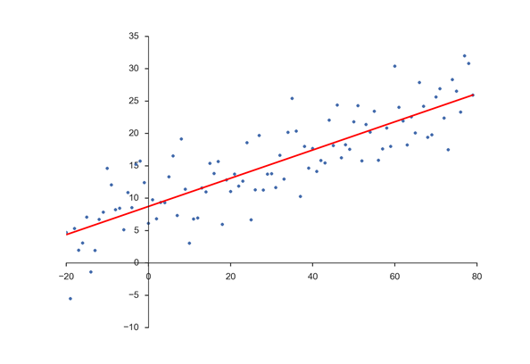
3) Regression Review and Extensions (Continued)

Slide 2
Qualitative Predictor Variables
Example
A researcher is interested in the effects of years of industry experience and gender on sales performance for a particular population of sales force professionals.
The qualitative characteristic (gender) will be incorporated in the model using a 0,1 indicator (dummy) variable defined as follows:
X₂ = 1 if female, 0 otherwise (male)
Note that with two categories we only need one indicator variable.
The category coded as 0 is called the reference or base category.
In general, a qualitative variable with c classes will be represented by c – 1 indicator variables.
Our resulting model is as follows:
Y_{i} = β_{o} + β₁X₁ + β₂X₂ + ε
Where X₁ = years of industry experience
X₂ ₌ 1 if female, 0 otherwise (male)

Slide 3
Interpretation of Coefficients
The associated regression function is
β_{o} + β₁X₁ + β₂X₂
For men, X₂ = 0 β_{o} + β₁X₁
For women, X₂ = 1 β_{o} + β₁X₁ + β₂
(β_{o} + β₂) + β₁X₁
Sales
Yrs. Exp. (X1)

Slide 4
Model Containing Interaction Effects
Extending our model, suppose there could be differences both in the intercepts and slopes between sales performance for men as compared to women.
The associated model is: Y_{i} = β_{o} + β₁X₁ + β₂X₂ + β₃ X₁X₂ + ε
Where X₁ = years of industry experience
X₂ ₌ 1 if female, 0 otherwise (male)
X₁X₂ = interaction variable
Interpretation of Coefficients
For men, X₂ = 0 β_{o} + β₁X₁
For women, X₂ = 1
β_{o} + β₁X₁ + β₂ + β₃ X₁
(β_{o} + β₂) + (β₁ + β₃)X₁

Slide 5
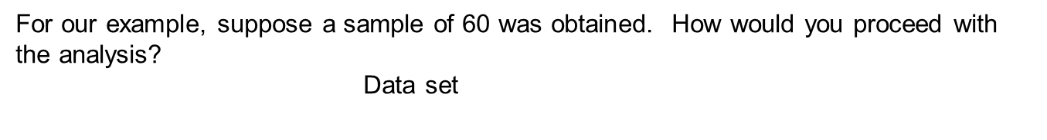
M
Sales
Yrs. Experience (X1)
Data in file Sales.force.Sales.sav
Obs | YrsExp | Gender | YG | Sales ($0000)
1 | 27 | 0 | 0 | 158.83
2 | 29 | 0 | 0 | 161.22
3 | 25 | 0 | 0 | 161.88
. | . | . | . | .
. | . | . | . | .
. | . | . | . | .
58 | 17 | 1 | 17 | 151.16
59 | 12 | 1 | 12 | 113.73
60 | 21 | 1 | 21 | 157.36

Slide 7
Qualitative Variable with More than Two Classes
Example
Atlantis bread company supplies bread to a large no. of supermarkets in Atlanta. To study the effects of shelf display height (bottom, middle, top) on sales (measured in cases) twelve supermarkets were selected. Four stores were randomly assigned to each of the 3 shelf heights. Management is interested in the potential relation between shelf display height and sales. Conduct a regression analysis using the resulting data in SPSS file Bread.sales.sav
With more than two classes of a qualitative variable, simply add the appropriate number of additional indicator variables.
Let X₁= 1 if top shelf, 0 otherwise
X₂ = 1 if middle shelf, 0 otherwise
The model is Y_{i} = β_{o} + β₁X₁ + β₂X₂ + ε
Interpretation: for bottom shelf E[Y] = β_{o}
for top shelf E[Y] = β_{o +} β₁
for middle shelf E[Y] = β_{o +} β₂

Slide 8
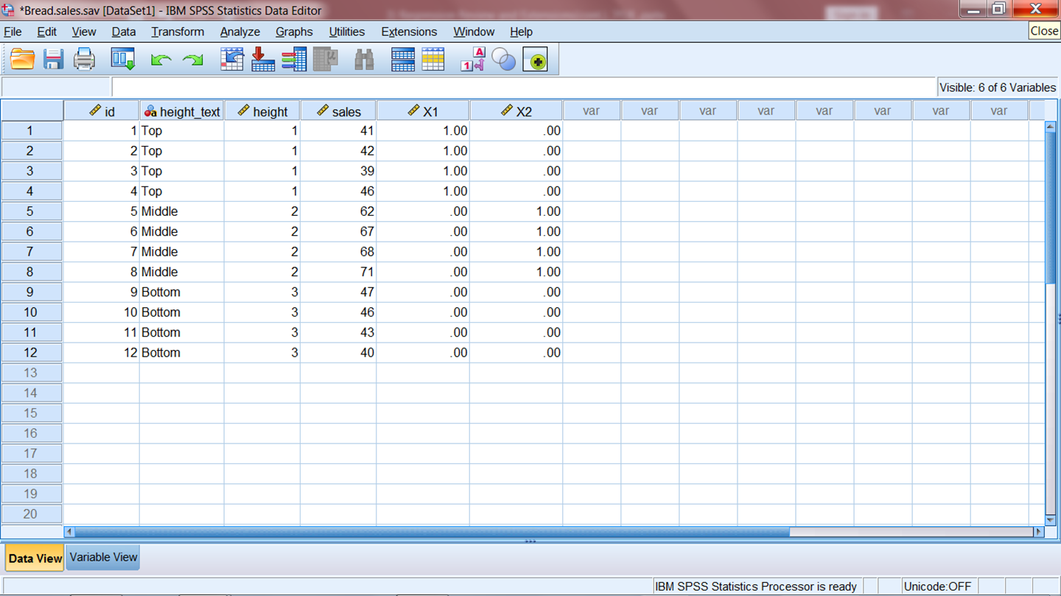
Bread.sales.sav file with Indicator (dummy) coding. X1 and X2 created using SPSS Transform, Recode into Different Variables

Slide 9
R square = .940
P-value for test
Ho: Β₁ = β₂ = 0
Note that this is testing if mean sales for all three heights are the same
Interpretation of regression results regarding mean sales ?
Sample means from SPSS Compare Means procedure

Slide 11
Effects Coding of Qualitative Predictors
So far, our applications have involved indicator (dummy) variables. However, there is another commonly used coding scheme called effects coding. As with indicator variables, effects coding uses one less variable than the number of levels in a qualitative variable, each level has a corresponding variable, except the reference level.
With effects coding, each variable has a one for the corresponding level, a minus one for the reference level, and zeros elsewhere.
For our Bread sales example , using bottom shelf as the reference, we have
XE1 = 1 if top self, -1 if bottom shelf, 0 otherwise
XE2 = 1 if middle shelf, -1 if bottom shelf, 0 otherwise
And the model would be
Y_{i} = β_{o} + β₁XE₁ + β₂XE₂ + ε
With this coding, β_{o} can be viewed as an overall or grand “average” from which the mean sales of the different heights differ as measured by the associated coefficients. Note that the sum of all the effects of a qualitative attribute equals 0.

Slide 12
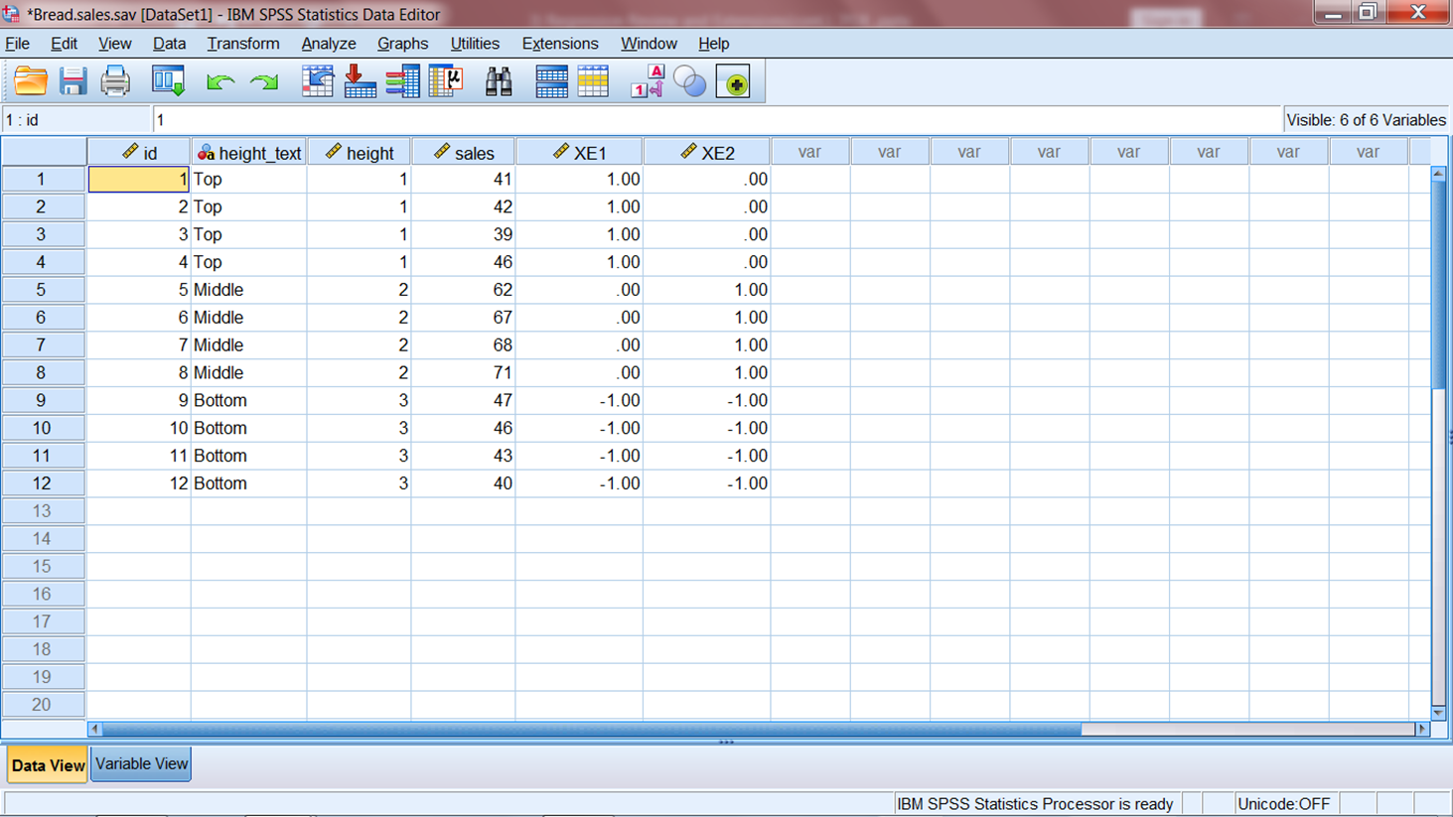
Bread.sales_EC.sav file with effects coding. XE1 and XE2 created using SPSS Transform, Recode into Different Variables

Slide 13
Interpretation: for top shelf E[Y] = β_{o +} β₁
for middle shelf E[Y] = β_{o +} β₂
for bottom shelf E[Y] = β_{o} + (-β₁ + -β₂)
R square = .940
Note that these results are the same as when we used dummy coding
Interpretation of estimated coefficients?

Slide 15
Multicollinearity
If the predictors are uncorrelated amongst themselves, or not highly correlated, then our usual inferences and interpretations are not affected/problematic. However, if the predictors are highly correlated amongst themselves, a condition called multicollinearity exists which causes problems with regard to inferences and interpretations regarding coefficients.

Slide 17
Effects of Multicollinearity
Estimated regression coefficients tend to have large sampling variability (standard errors). Therefore, information about true model coefficients is imprecise.

Slide 18
Contrast the last example with our Grocery Sales example that was a designed experiment (no correlations among predictors)

Slide 19
Detection of Multicollinearity
Informal Diagnostics:
Large changes in estimated coefficients when a predictor variable is added or dropped from model, or an observation is added or altered
Nonsignificant individual tests for coefficients of important explanatory variables
Estimated regression coefficients with strange signs (different from expectations)
Large pairwise correlations between predictors
The informal methods have important limitations. Not suited to provide a measure of the impact of multicollinearity, and some may exist without multicollinearity.
Variance Inflation Factors :
Provide a formal method for detecting and measuring multicollinearity.
Variance inflation factors measure the extent that the variance of a coefficient estimate is inflated due to multicollinearity, as compared to the case if predictors were completely uncorrelated.

Slide 20
Compare

Slide 21
Multicollinearity Remedial Measures Include:
Designed experiments
Dropping predictors from the model
Form composite indexes based on the highly correlated predictors

Slide 22
Variable Selection Methods
Forward Selection: Starting with no predictors in the model, predictors are entered one at a time if their corresponding P-values are less than some prespecified level.
Backward Elimination: Starting with all predictors in the model, predictors are removed one at a time if their corresponding P-values are larger than some prespecified level.
Stepwise: Forward selection is combined with backward elimination in a step by step fashion.
In general, when comparing the results of two models, the value of R square is not a good measure for comparison. R square can never decrease when predictors are added.
Instead, Adjusted R square should be used to make comparisons. Adjusted R square adjusts for the number of predictors.
R square = 1 - SSE/SST
Adj. R square = 1 - [ SSE/(n-k-1)/SST/(n-1)]

Slide 23
Example: An automobile manufacturer is interested in how to market a new type of performance car. A survey was performed and attitudinal measures were obtained on a 9 point scale (1= definitely disagree to 9= definitely agree), along with responses to a purchase intent question measured on a scale from 0 (definitely would not purchase) to 100 (definitely would purchase). Below are attitudinal questions used as explanatory variables in a multiple regression (n=400) (SPSS Data file Car.study.psyc.sav).
PI | purchase intent
Q1 | When I must choose, I dress for fash. not comf.
Q2 | I have more stylish clothes than my friends
Q3 | I have more self-confidence than my friends
Q4 | I like to be considered a leader
Q5 | I can do anything I set my mind to
Q6 | Five yrs from now my income will be a lot higher

Slide 24
 | Correlations
 | Q1 | Q2 | Q3 | Q4 | Q5 | Q6
Q1 When I must choose, I dress for fash. not comf. | 1 | 0.804 | 0.059 | 0.034 | 0.125 | 0.104
Q2 I have more stylish clothes than my friends | 0.804 | 1 | 0.084 | 0.064 | 0.145 | 0.123
Q3 I have more self-confidence than my friends | 0.059 | 0.084 | 1 | 0.813 | 0.076 | 0.066
Q4 I like to be considered a leader | 0.034 | 0.064 | 0.813 | 1 | 0.131 | 0.119
Q5 I can do anything I set my mind to | 0.125 | 0.145 | 0.076 | 0.131 | 1 | 0.952
Q6 Five yrs from now my income will be a lot higher | 0.104 | 0.123 | 0.066 | 0.119 | 0.952 | 1
The bottom results produced from backward elimination run with P-val to remove =.05. Note the variance inflation factors.
(Tolerance is the reciprocal of VIF)

Slide 25
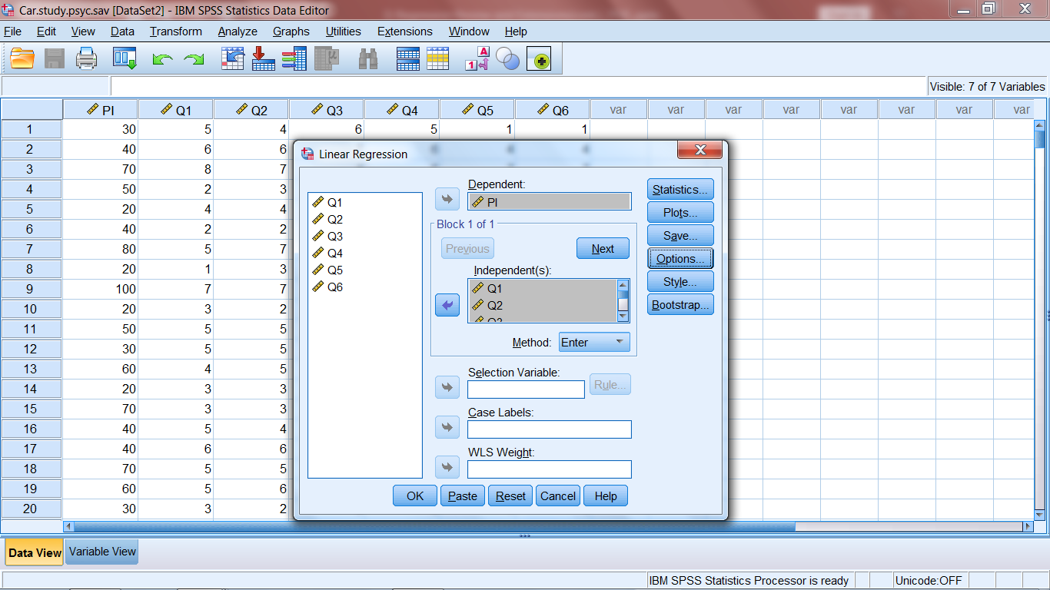

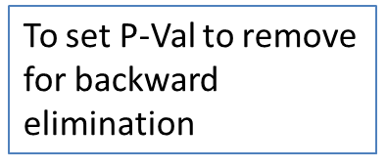
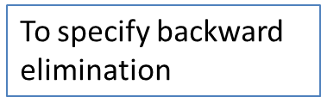

Slide 26
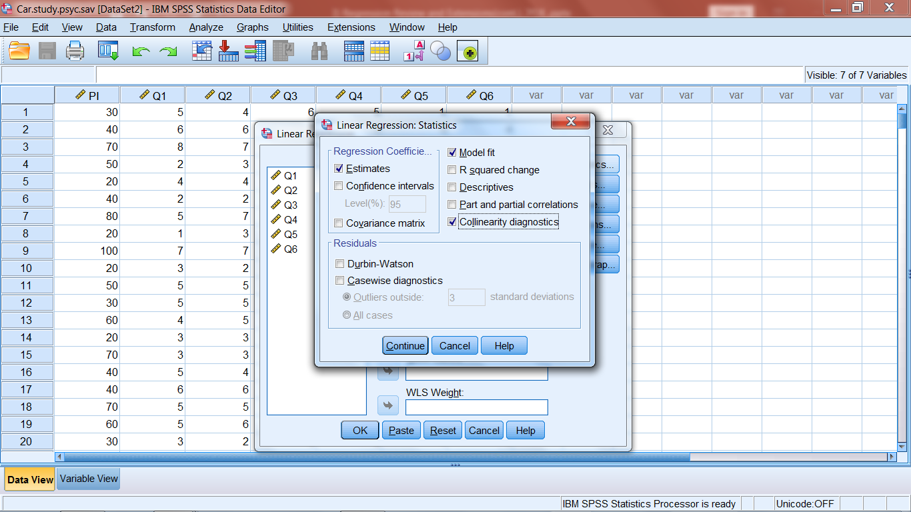

Slide 27
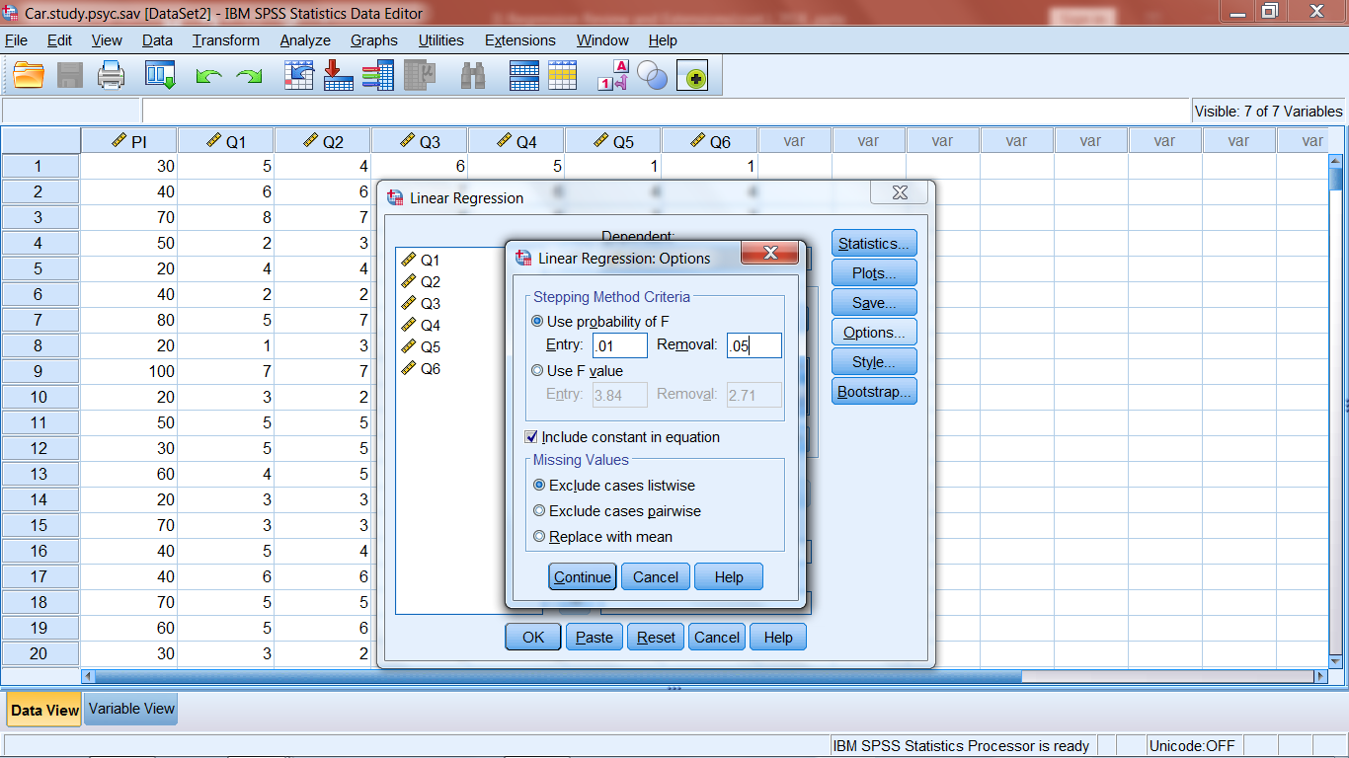

Slide 28
Added Application 2)
A consultant studied the relation between selling price and assessed valuation of one-family dwellings in a district for a sample of 64 recent sales. In addition, the dwellings were identified as to whether the dwelling was located on a corner lot.
File Corner_lot.sav has the data with the following variables: Selling price (the dependent variable) in $000 (SP), assessed valuation in $000 (AV), and lot location indicator (CL) (1= corner lot, 0 = non – corner lot). Estimate an appropriate model and interpret your results.

Slide 29
Added Application 3)
SPSS file “CRE_data_est_smp.sav” is a commercial real estate data set (600 records) with information on age in years, operating expenses and taxes in $ per sq.ft., vacancy rate, total square footage, and rental rate in $ per sq.ft.
Perform a regression analysis to obtain a forecasting model for rental rate.
Excel file CRE_data_val_smp.xlsx contains data for 400 additional properties. Use this data set to evaluate the model you obtained in a). Provide a Word document of your output and explanation of your evaluation.

Slide 30
SAS Code for Class Examples
Sales Force Sales Example
proc import datafile="D:\_UGA\7600\Class_5\Data\SalesForceSales.sav" DBMS=SAV OUT=sfs;
run;
proc reg data=sfs;
model sales= yrs gender yg;
model sales= yrs gender;
run;
Atlantis Bread Sales Example
proc import datafile="D:\_UGA\7600\Class_5\Data\BreadSales.sav" DBMS=SAV OUT=bsls;
run;
proc import datafile="D:\_UGA\7600\Class_5\Data\BreadSales_EC.sav" DBMS=SAV OUT=bsls_ec;
run;
proc reg data=bsls;
model sales = X1 X2;
run;
proc reg data=bsls_ec;
model sales = XE1 XE2;
run;

Slide 31
Performance Car Example
proc import datafile="D:\_UGA\7600\Class_5\Data\CarStudyPsyc.sav" DBMS=SAV OUT=csp;
run;
proc reg data=csp;
model pi = q1 - q6/vif; *vif requests the variance inflation factors;
run;
proc reg data=csp;
model pi = q1 - q6/vif selection = backward sls=.05;
*backward selection with prob. to remove = .05. other options include selection =stepwise
and selection=forward (sle=.05 specifies prob to enter). By default, sle=.15, sls=.15;
run;

